Slide 1








OPEN HOUSE
2nd Grade
Copeland Elementary School

Slide 2


Parents and Guardians
It’s that time of year again! We want to welcome you and your child to the new school year! We are looking forward to having your child in my class this year and want to do what we can to best support your child. You will fill out a form to help me get to know you and your child better. Please fill out this form and return it before leaving. It will help me, as your child’s teacher, to set goals for myself to make sure I can make this school year great. I am excited to hear from you and ecstatic about this upcoming school year.
Sincerely,
The Second Grade Team

Slide 3
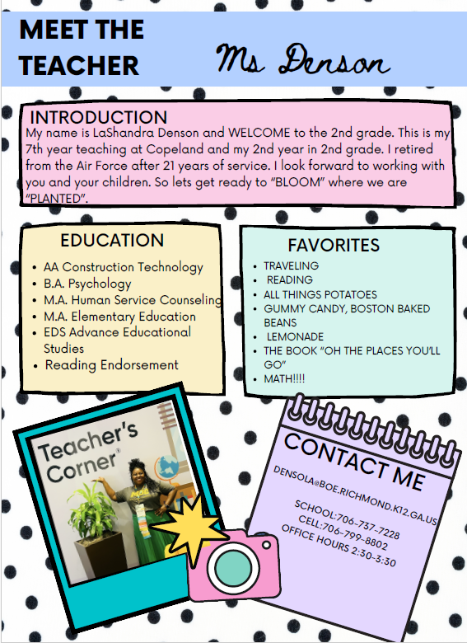

Slide 4
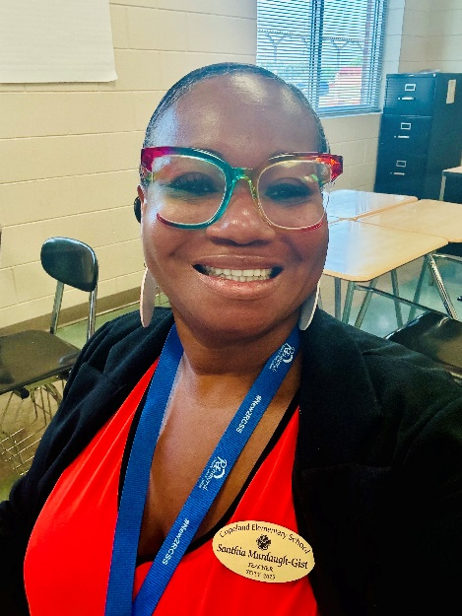
Welcome to 2nd Grade
Meet Ms. Murdaugh-Gist
I was born and raised in Columbia County. I graduated from Evans High School. I have a Master’s degree in Organizational Management (Human Resources Management) and also a Master’s degree in Elementary Education. I am currently actively enrolled in my Educational Leadership Specialist Degree Program. I have been teaching at Copeland since 2019. My husband is also a teacher. Together we have six children and one grandson. I enjoy working with children and setting and reaching successful growth goals.
Book: Bible
Color: Green
MurdaSa@boe.Richmond.k12.ga.us
Telephone: 706-834-8553
Please Join our Class DOJO
Food: Italian/Mexican
Sport- Bowling
Drink: Water and Sparkling Water (Waterloo) , Sugar free coffee

Slide 5
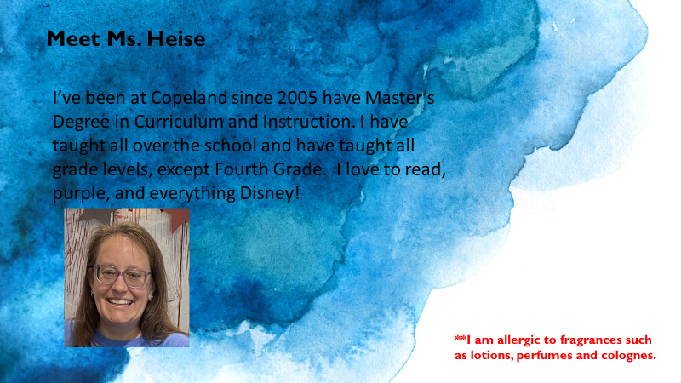

Slide 6

2nd Grade Supply List
· Headphones /earbuds.
· 2 packs of black dry erase markers
· 2 primary journal composition books
· 1 box gallon zip lock bags
· #2 pencils (No mechanical
· Glue sticks
· Kleenex tissue
· Highlighter Markers
· Pink eraser
· Pair of scissors
· Pencil box or pouch
· Box of crayons
· Index cards
· Post-it-Notes
· 2 pkg wide-ruled loose-leaf paper
· Composition notebooks (4)
· Three pocket folders (Take Home Tuesday folder, Daily Folder & Homework Folder)
· Hand Sanitizer (for your child)
Donations of the following are greatly appreciated:
Hand sanitizers, air freshener, antibacterial wipes, Kleenex, pencils,non-bleach cleaning spray, classroom non-perishable treats (nut free

Slide 7
2nd Grade Curriculum
Literacy: WILSON Language Fundations, Heggerty & Savvas My View
Math: GaDoe Learning Plans/Ready Math
Social Studies: Studies Weekly
Science: MaGraw Hill Inspire Georgia Science

Slide 8
WILDCAT Weekly Wednesday
All important school updates and communications will be sent home in your student's WILDCAT WEEKLY take-home FOLDER.

Slide 9

Transportation
All transportation changes must be in writing by noon! We cannot take your child’s word or last minute changes! Please contact the teacher through Class DoJo.
NO STUDENT OFFICE DISMISSAL AFTER: 1:45

Slide 10

Is our class form of COMMUNICATION

Slide 11


IMPORTANT INFORMATION
News
Included on the conduct calendar will be essential reminders and important dates. All other updates will be sent home on WILDCAT Wednesday.
Conduct
Respectful behavior is expected and important to ensure a productive learning environment. We are a PBIS school and our behavior management system is linked with Class DoJo and Spotlight.
Lunch
Students can bring a $1.00 for ice cream or additional items for lunch. You may bring cupcakes or other items to lunch to celebrate a birthday. Only store bought items are allowed.

Slide 12






